Slide 1
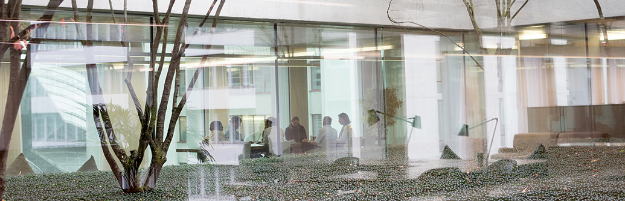
Sepsis subgroup analysis
Global Drug Development Advanced Exploratory Analytics

Slide 2
The Sepsis Data
Sepsis dataset is a simulated clinical trial with two groups treatment about sepsis disease. This dataset contains simulated data on 470 subjects with a binary outcome survival, that stores survival status for patient after 28 days of treatment, value of 1 for subjects who died after 28 days and 0 otherwise. There are 11 covariates, all of which are numerical variables.
True subgroup is PRAPACHE <= 26 & AGE <= 49.80.
NOTE: This true subgroup is defined with the lower event rate (survival = 1) in treatement arm. Therefore in following examples we’ll search the subgroup with the highest event rate, and we know it is PRAPACHE > 26 & AGE > 49.80.

Slide 3

Model Building Virtual Twins
Build two model using a selected algorithm, The first model applies the opposite treatment to the second model and Vice Versa, after that we calculate the treatment effect p1-p0 and build the model using a DecisionTreeRegressor to find the possible strong biomarkers and subgroup.
1. Derive predictive model for control arm p(Y=1|X,T=0)
1. Derive predictive model for active arm p(Y=1|X,T=1)
3. Apply active model to control data
4. Apply control model to active data
Control
Active
Control
Active

Slide 4
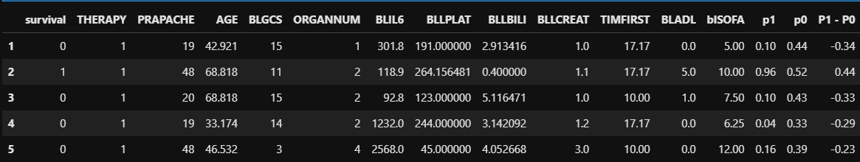
The Data
After applying the active group to the control group and otherwise, we store p1 and p0
of the actual survivals for the active and control group before getting our new predictions
and appending them with the expected prediction if the patient fell in the opposite group.

Slide 5
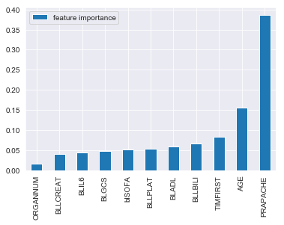
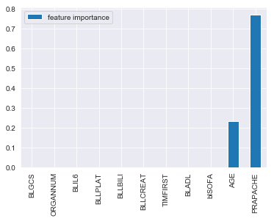
Build models using RandomForest
After building both models with random forest ,we used a Decisiontree algorithm to train model and find the important feature and reduced the max depth to 2.
Full model
Max depth 2

Slide 6
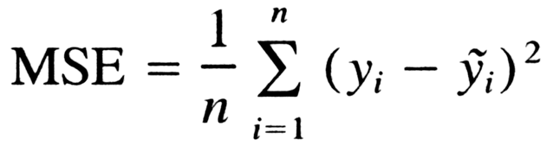
The DecisionTree Regressor uses the smallest MSE of target variable to find it’s splits (best splits) from root node down to leaf nodes.
The full model is built off with all the features, the second model prunes the tree to a
depth of two which uses only two features in the data (PRAPACHE & AGE).

Slide 7
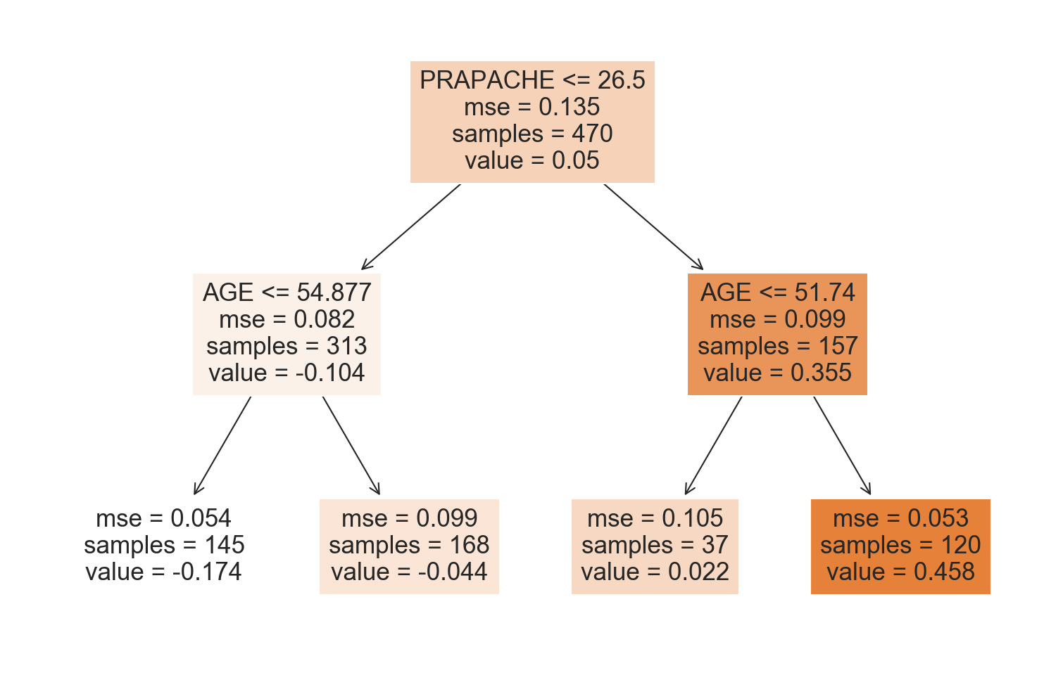
Build models using RandomForest...
Subgroup from this model will be PRAPACHE <= 26.5 and AGE <=54.877 with the lowest effect of -0.174
TRUE SG PRAPACHE <= 26 & AGE <= 49.80

Slide 8
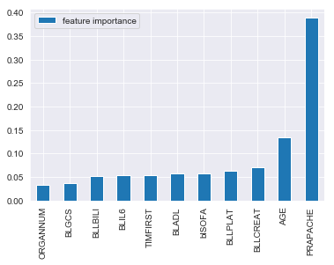
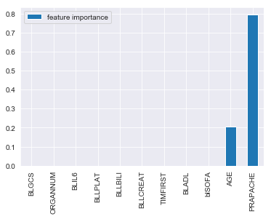
Build models using RandomForest Tuned
After building both models with random forest Tuned ,we used a Decisiontree algorithm to train model and find the important feature and reduced the max depth to 2.
Full model
Max depth 2

Slide 9

Build models using RandomForest Tunded...
Subgroup from this model will be PRAPACHE <= 26.5 and AGE <=67.354 with the lowest effect of -0.121
TRUE SG PRAPACHE <= 26 & AGE <= 49.80

Slide 10
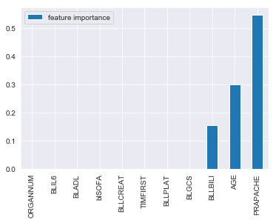
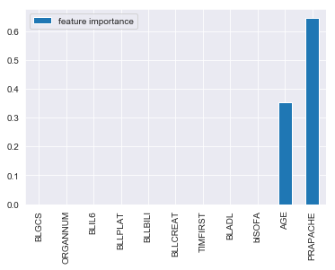
Build models using Adaboost Tuned
After building both models with adaboost Tuned ,we used a Decisiontree algorithm to train model and find the important feature and reduced the max depth to 2.
Full model
Max depth 2

Slide 11
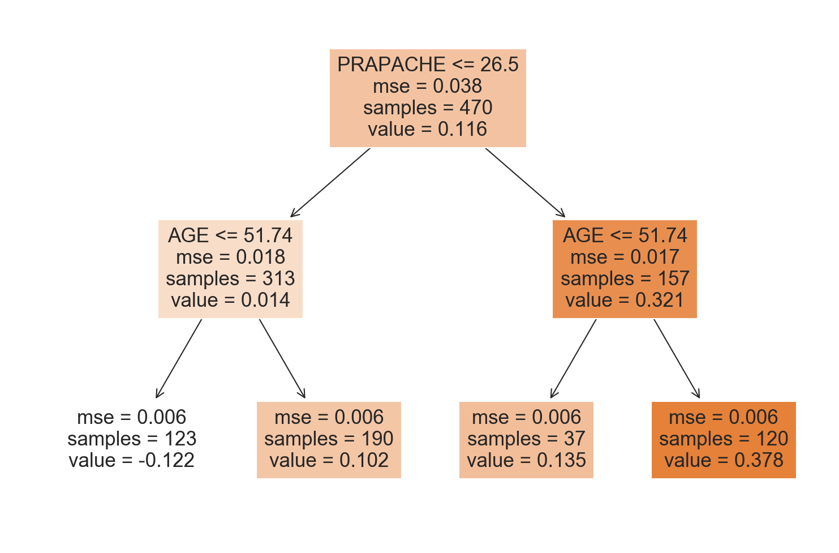
Build models using Adaboost Tuned...
Subgroup from this model will be PRAPACHE <= 26.5 and AGE <=51.74 with the lowest effect of -0.122
TRUE SG PRAPACHE <= 26 & AGE <= 49.80

Slide 12
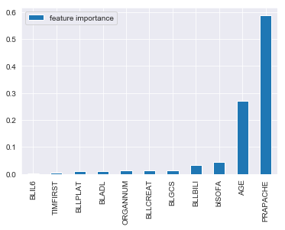
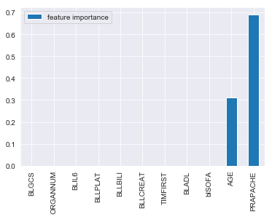
Build models using Gradientboost Tuned
After building both models with gradient boost Tuned ,we used a Decisiontree algorithm to train model and find the important feature and reduced the max depth to 2.
Full model
Max depth 2

Slide 13
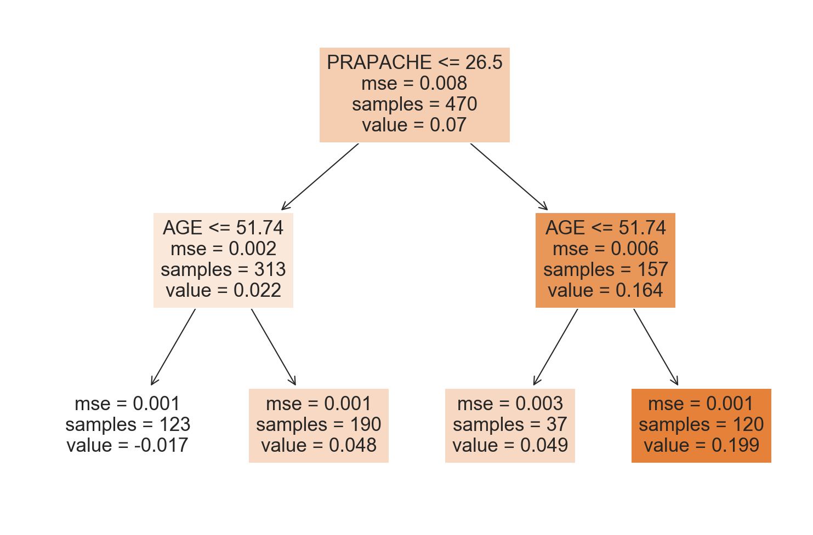
Build models using Gradientboost Tuned...
Subgroup from this model will be PRAPACHE <= 26.5 and AGE <=51.74 with the lowest effect of -0.017
TRUE SG PRAPACHE <= 26 & AGE <= 49.80

Slide 14
Subgroups and results terms
Subgroup Size: the size of the subgroup based off on each models
Treatment Event Rate: the probability of survival when in treatment group i.e THERAPY = 1. TER = P( S = 1 | X,T=1 )
Control Event Rate: the probability of survival when in control group i.e THERAPY = 0. CER = P( S = 1 | X,T=0 )
Treatment Sample Size: the length of the data that belongs to the treatment group
Control Sample Size: the length of the data that belongs to the control group
TER - CER: the difference of both event rates.
Notes:
Standard supervised learning scenario.
Filter Methods.

Slide 15
Subgroups and results
Model | Subgroup | Subgroup Size | Treatment event rate(TER) | Treatment sample size | Control event rate(CER) | Control sample size | TER - CER
Random Forest | PRAPACHE <= 26.5 & AGE <= 54.877 | 145 | 0.1053 | 95 | 0.28 | 50 | -0.1747
Random Forest Tuned | PRAPACHE <= 26.5 & AGE <= 67.354 | 230 | 0.16 | 150 | 0.3125 | 80 | -0.1525
Adaboost | PRAPACHE <= 26.5 & AGE <= 51.74 | 123 | 0.0732 | 82 | 0.2195 | 41 | -0.1463
Gradientboost | PRAPACHE <= 26.5 & AGE <= 51.74 | 123 | 0.0732 | 82 | 0.2195 | 41 | -0.1463
True Subgroup | PRAPACHE <= 26 & AGE <= 49.80 | 100 | 0.0597 | 67 | 0.1818 | 33 | -0.1221
Notes:
Standard supervised learning scenario.
Filter Methods.

Slide 16
Classification report
The classification report was generated based of using the subgroup for gradient boost
assuming it’s our best model compared to the true subgroup we already know.
100 patients were classified in our true subgroup and 123 from our gradient boosting
Method. We then separate them by the survival and non survival to find out the
number of subgroups that were correctly predicted.
 | Survival | Non Survival
survival | 10 TP | 5 FP
Non survival | 18 FN | 90 TN
From the 100 in the true subgroup,
TN = 90, TP=10.
The remaining incorrect 23 predictions,
18 were FN and 5 were FP
TRUE SB PRAPACHE <= 26 & AGE <= 49.80
Notes:
Standard supervised learning scenario.
Filter Methods.

Slide 17
Classification report
 | Survival | Non Survival
survival | 10 TP | 5 FP
Non survival | 18 FN | 90 TN
Accuracy = (TP + TN)/total.
10+90/123 =0.813
TPR = TP/(TP + FN)
10/10 + 18 = 0.357
TNR = TN/(FP + TN)
90/5 + 90 = 0.95
TRUE SB PRAPACHE <= 26 & AGE <= 49.80
Notes:
Standard supervised learning scenario.
Filter Methods.

Slide 18

Thank you!
Global Drug Development Advanced Exploratory Analytics

